Slide 1


C.K. Pithawala College Of Commerce Management
And Computer Application
PAYROLL MANAGEMENT SYSTEM

Slide 2
Payroll Management System
INTRODUCTION
A payroll management system is a software application that automates the process of calculating and paying employee salaries.
Payroll management systems can save businesses time and money by eliminating the need for manual calculations and processing.
Project Profile :
Project Title : Payroll-Management-System
Project Duration : 2 Months
Team Members : Vishwakarma Abhishek, Dubey Vishal, Vasava Chirag Rudesh

Slide 3
Payroll Management System
Environment Description
Hardware Requirements
Processor : Intel core i3 or higher
SSD : 256GB or higher
RAM : 4GB or higher
Soft Requirements
Windows 7 or higher
JavaScript
Microsoft visual studio code
Xammp Apache
Google Chrome
PHP

Slide 4
Payroll Management System
System Analysis & Planning
Existing System
greytHR
Keke HR
HROne
Workday HCM
Drawbacks of above system:
High cost : implementing and maintaining of can be high.
Inflexibility : Traditional system can be difficult to adapt changes employee info.
Difficult to scale : Manual system can be difficult to scale as a company grows

Slide 5
Payroll Management System
System Analysis & Planning
Requirement gathering and analysis:
Payroll compliance : The system must be able to calculate and deduct all applicable taxes.
Expense management : The system must be able to track and manage employee expense
Dashboard & Reporting : The system must provide a dashboard with real-time data on payroll, expense, and other financial information.

Slide 6
Payroll Management System
Proposed System
Scope
To develop a user-friendly and efficient payroll management system that automates the process of calculating and disbursing employee salaries, bonuses, and deductions.
To ensure compliance with all relevant tax laws and regulations.
To provide accurate and timely payroll reports.
To improve the efficiency of the HR department by freeing up time to focus on other tasks.
To improve employee satisfaction by ensuring that they are paid accurately and on time.

Slide 7
Payroll Management System
Proposed System
Project Modules:
Admin
Login
Add employee
Employee details
Employee update
Add Department
Add Shift
Send Message
Take Attendance
Calculate Salaries

Slide 8
Payroll Management System
Proposed System
Project Modules:
Employees
Login
View Attendance
Profile
Change Password
View Salary Details
Print Pay Slip

Slide 9
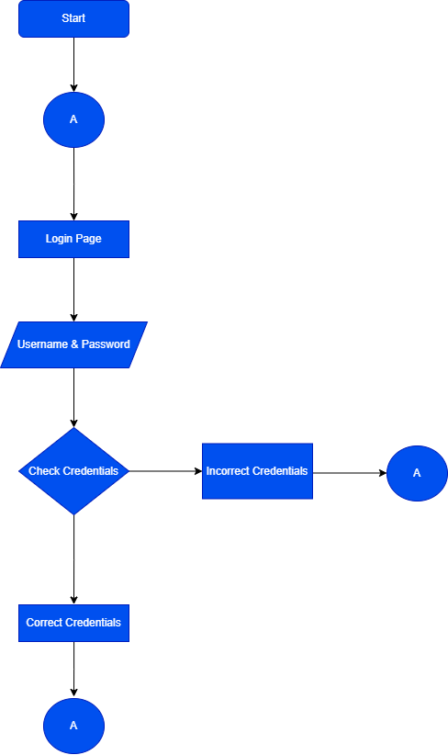
Payroll Management System
Payroll Management System
Detail Planning
Process Specification / Activity Flow Diagram
Admin side

Slide 10
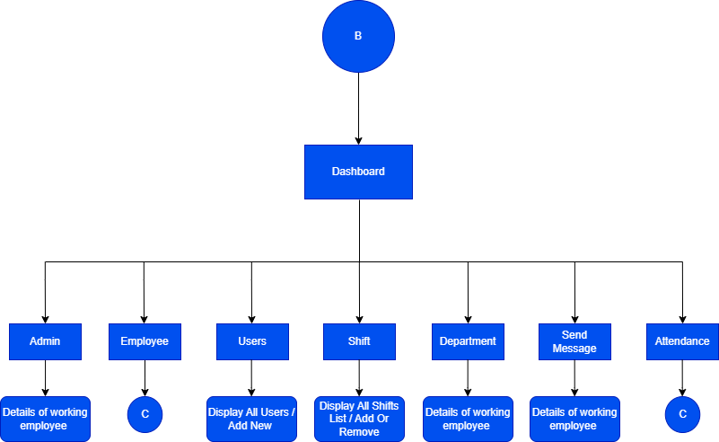
Payroll Management System
Payroll Management System
Detail Planning
Process Specification / Activity Flow Diagram
Admin side

Slide 11
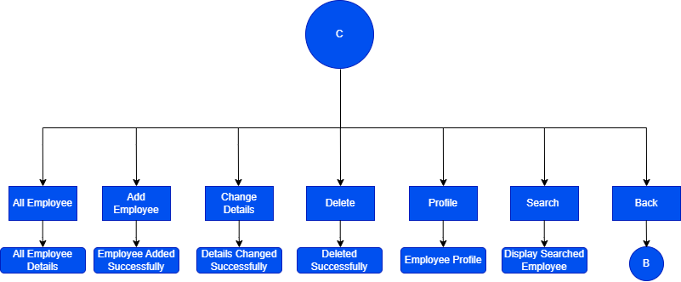
Payroll Management System
Payroll Management System
Detail Planning
Process Specification / Activity Flow Diagram
Admin side

Slide 12
Payroll Management System
Payroll Management System
Detail Planning
Process Specification / Activity Flow Diagram
Employee Side

Slide 13
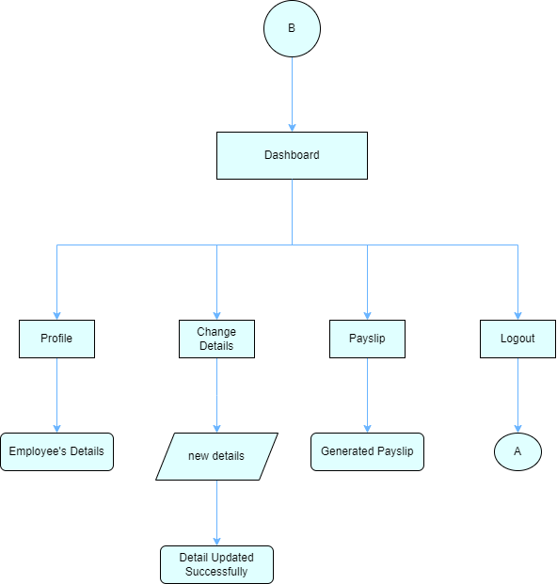
Payroll Management System
Payroll Management System
Detail Planning
Process Specification / Activity Flow Diagram
Employee Side

Slide 14
Payroll Management System
Detail Planning
Data Dictionary
Admin Table
Field Name | Data Type | Description
Id | Int(11) | Unique identifier for admin
First_Name | Text | First Name of the admin
Last_Name | Text | Last Name of the admin
Email | Text | Email address of admin
Department | Text | Department of admin
Shit_Name | Text | Shift name of admin
Phone_Number | Text | Phone number of admin
Address | Text | Address of admin residence
Date_Of_Birth | Date | Date of birth of admin
Date_Of_Joining | Date | Date of joining
Gender | Text | Gender of admin
Username | Text | Username of admin
Password | Text | Pass code to login into the system
AdminProfile_Picture | Varchar(20) | Profile pictire of admin

Slide 15
Payroll Management System
Detail Planning
Data Dictionary
Employee Table
Field Name | Data Type | Description
Id | Int(11) | Unique identifier for employee
First_Name | Text | First Name of the employee
Last_Name | Text | Last Name of the employee
Email | Text | Email address of employee
Department | Text | Department of employee
Shit_Name | Text | Shift name of employee
Phone_Number | Text | Phone number of employee
Address | Text | Address of employee residence
Date_Of_Birth | Date | Date of birth of employee
Date_Of_Joining | Date | Date of joining
Gender | Text | Gender of employee
Username | Text | Username of employee
Password | Text | Pass code to login into the system
AdminProfile_Picture | Varchar(20) | Profile pictire of employee

Slide 16
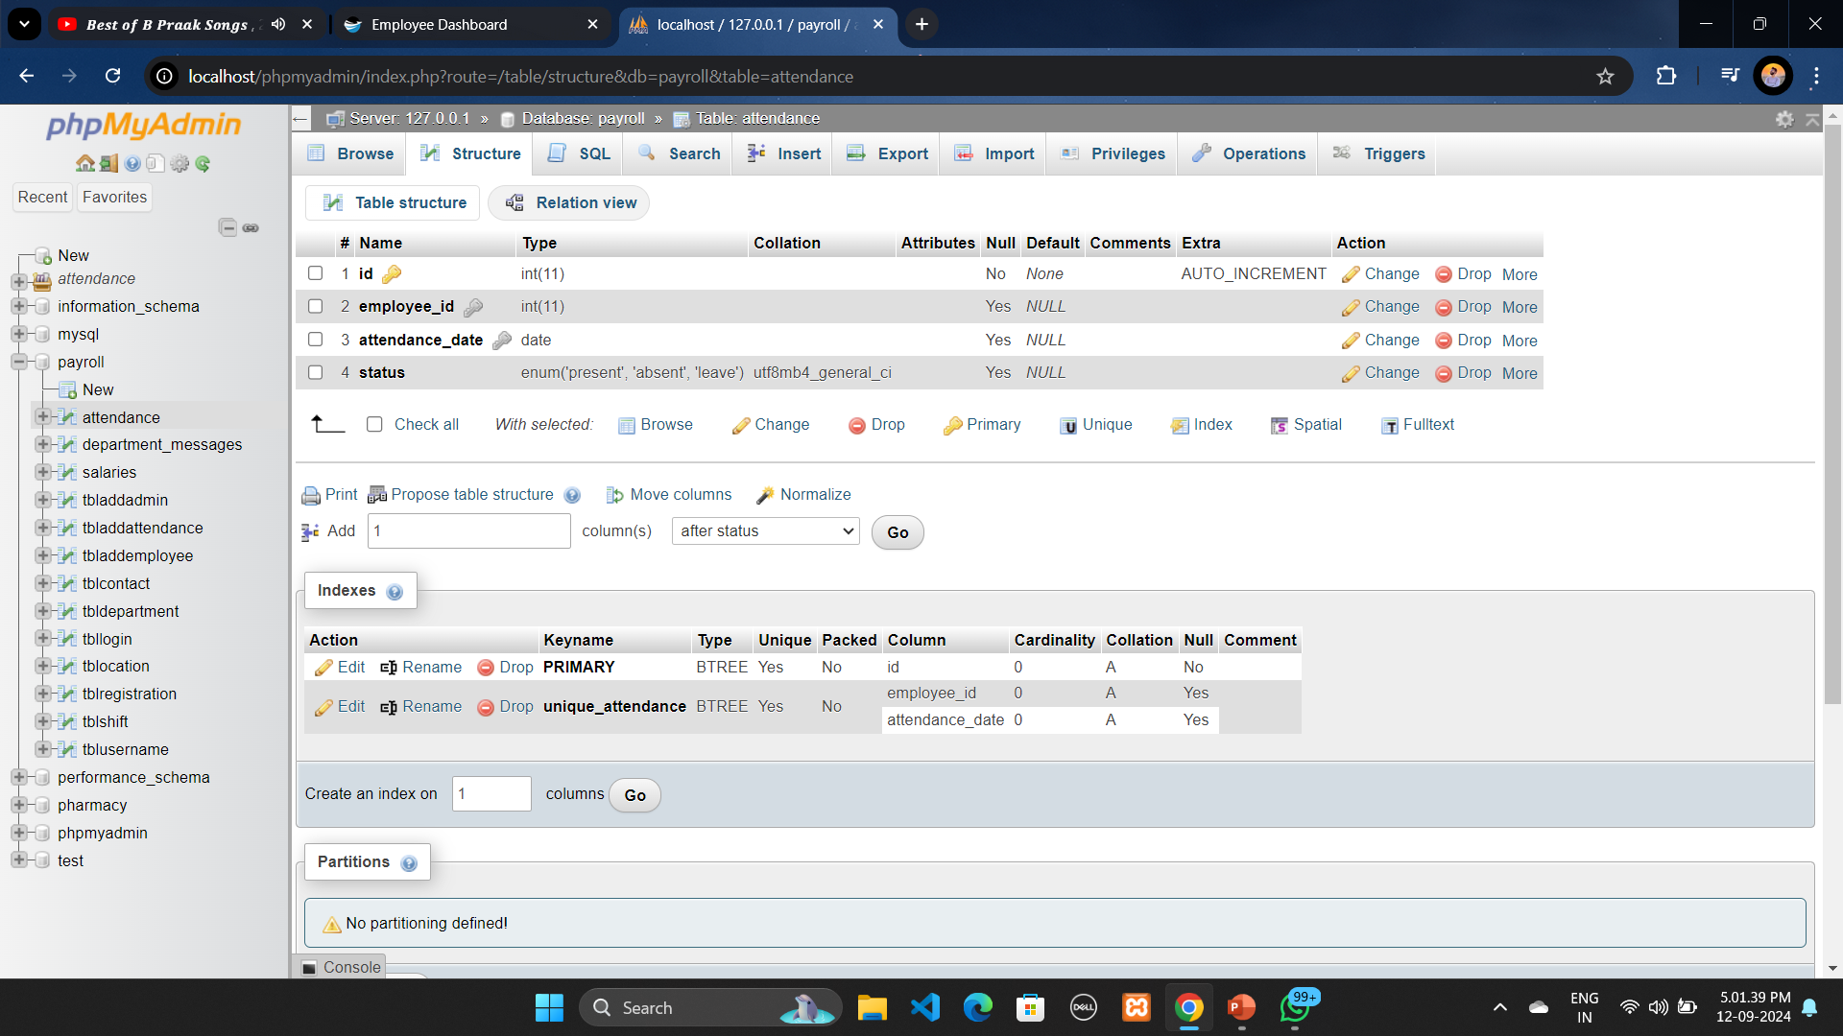
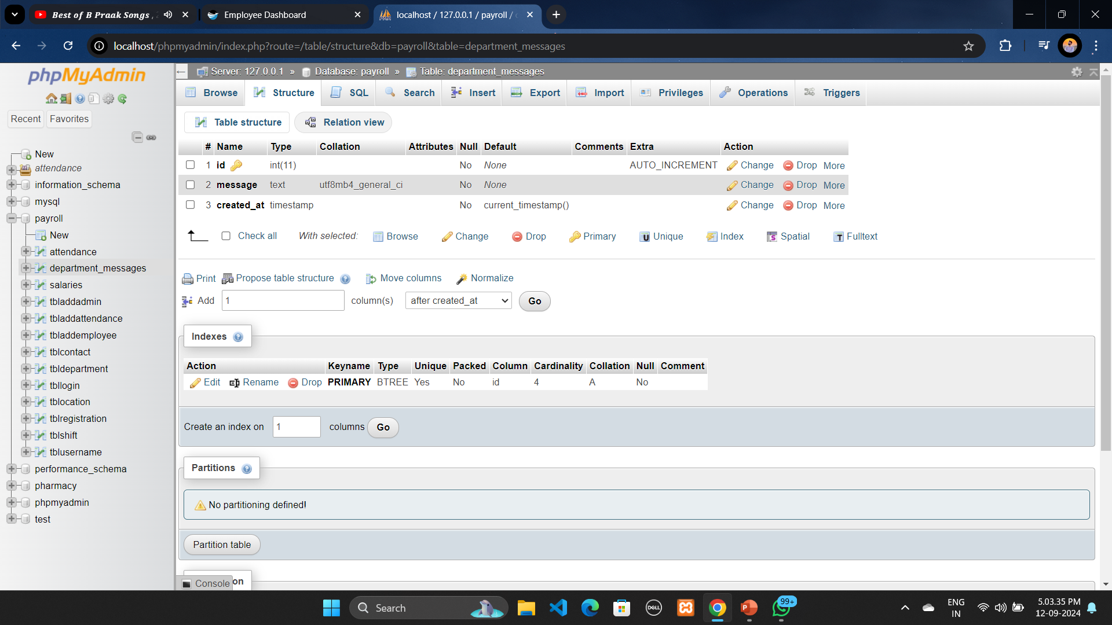
Payroll Management System
Detail Planning
Data Dictionary
Department Table
Message Table

Slide 17
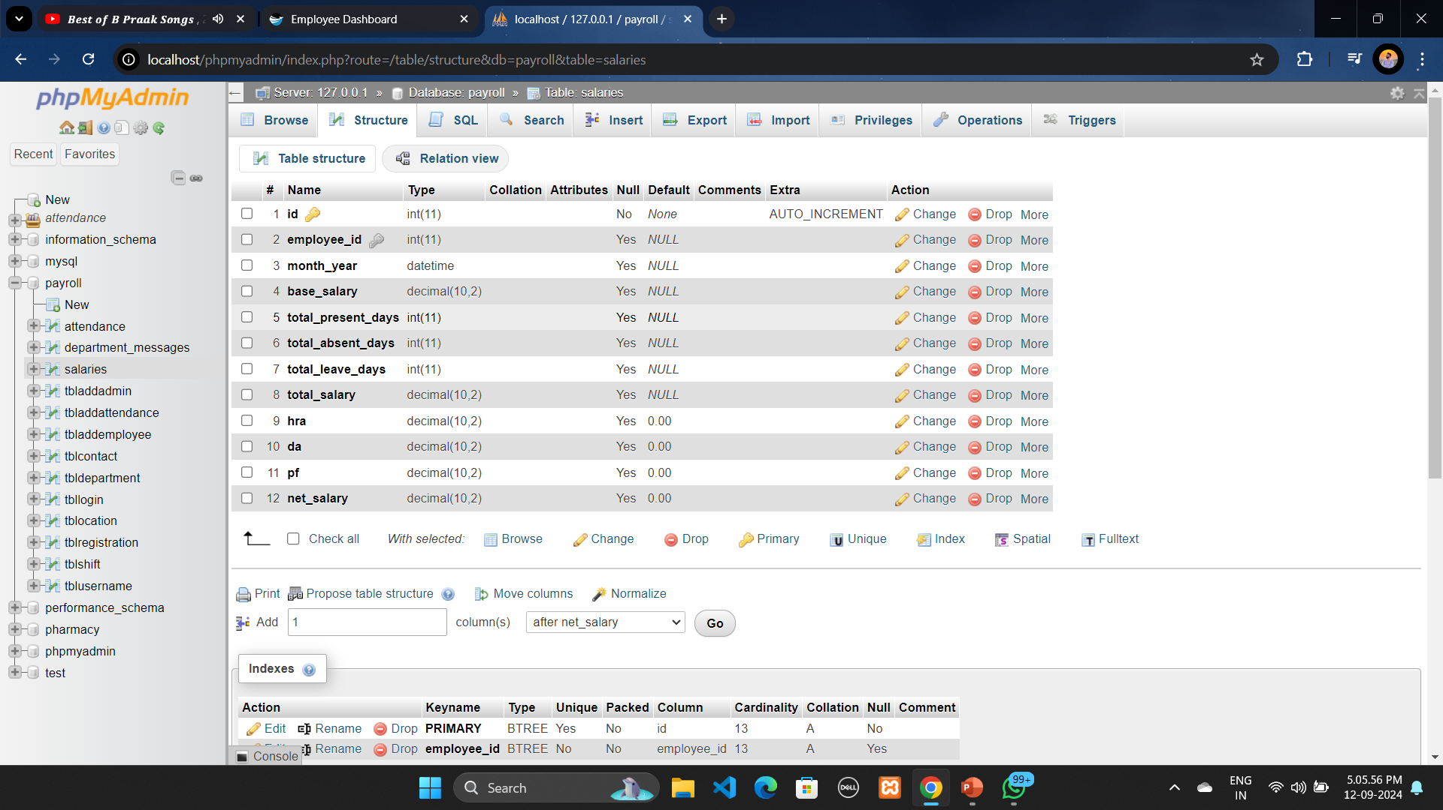
Payroll Management System
Detail Planning
Data Dictionary
Salaries Table

Slide 18
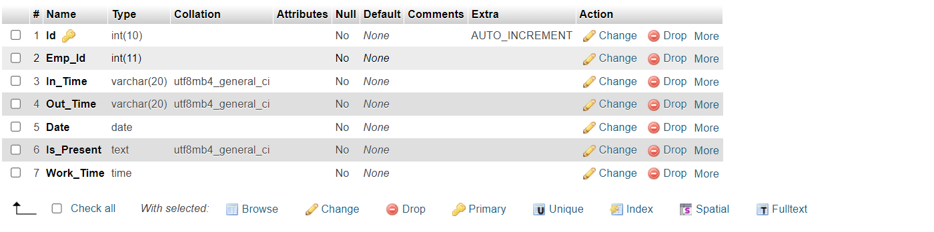
Payroll Management System
Detail Planning
Data Dictionary
Attendance Table

Slide 19
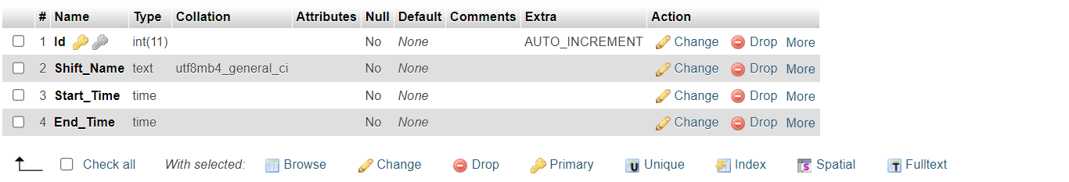
Payroll Management System
Detail Planning
Data Dictionary
Shift Table

Slide 20
Payroll Management System
System Desing
Database Design
Admin Table:
This table stores the basic information about admin, such as id unique identifier, name for login purpose, email, password for login into the system.
Employee Table:
This table stores the basic information about each employee, such as employee id, first and last name, email address, phone number, gender, date of birth, joining and hiring date of the employee, designation of the employee and the salary of the employee

Slide 21
Payroll Management System
System Desing
Database Design
Department Table:
This table stores the basic information about departments of the organization in which employees can work
Salary Table:
This table stores the information of employees base salary net salary and his tax deductions
Message Table: This table stores the messages which is passed by admin to all employees

Slide 22
Payroll Management System
System Desing
Database Design
Attendance Table:
This table stores the basic information about employees daily attendance.
Shift Table:
This table stores the basic information about working shifts in the organization.

Slide 23
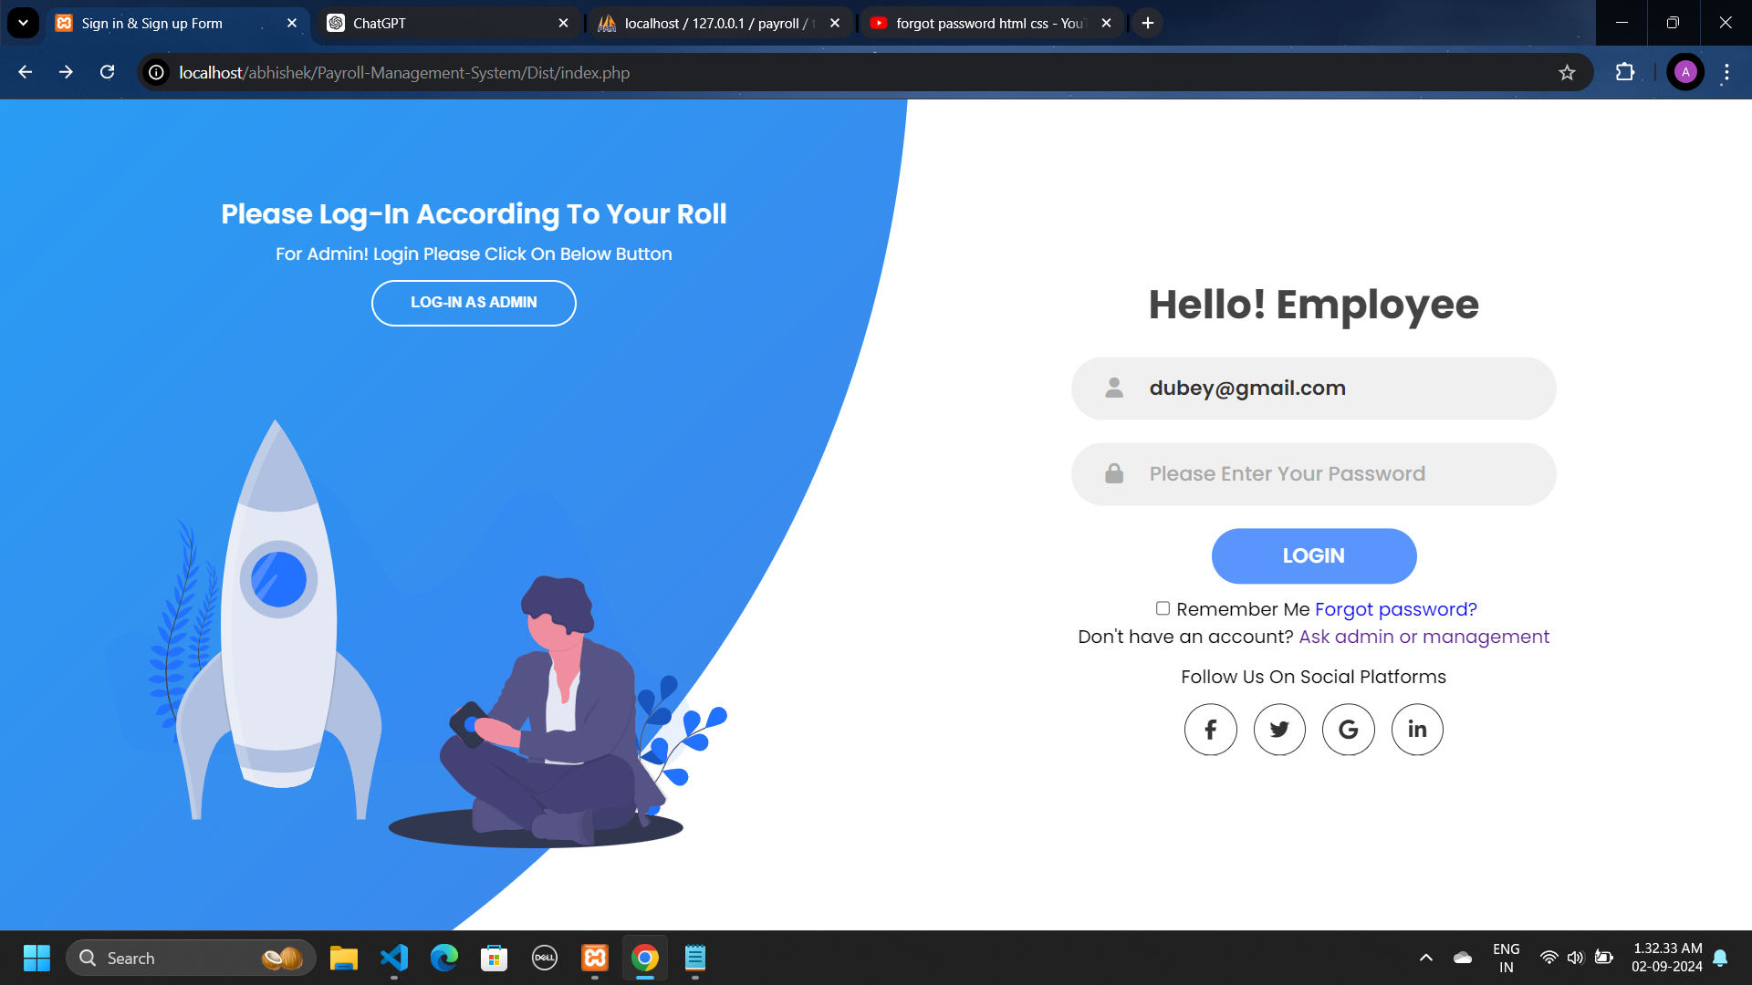
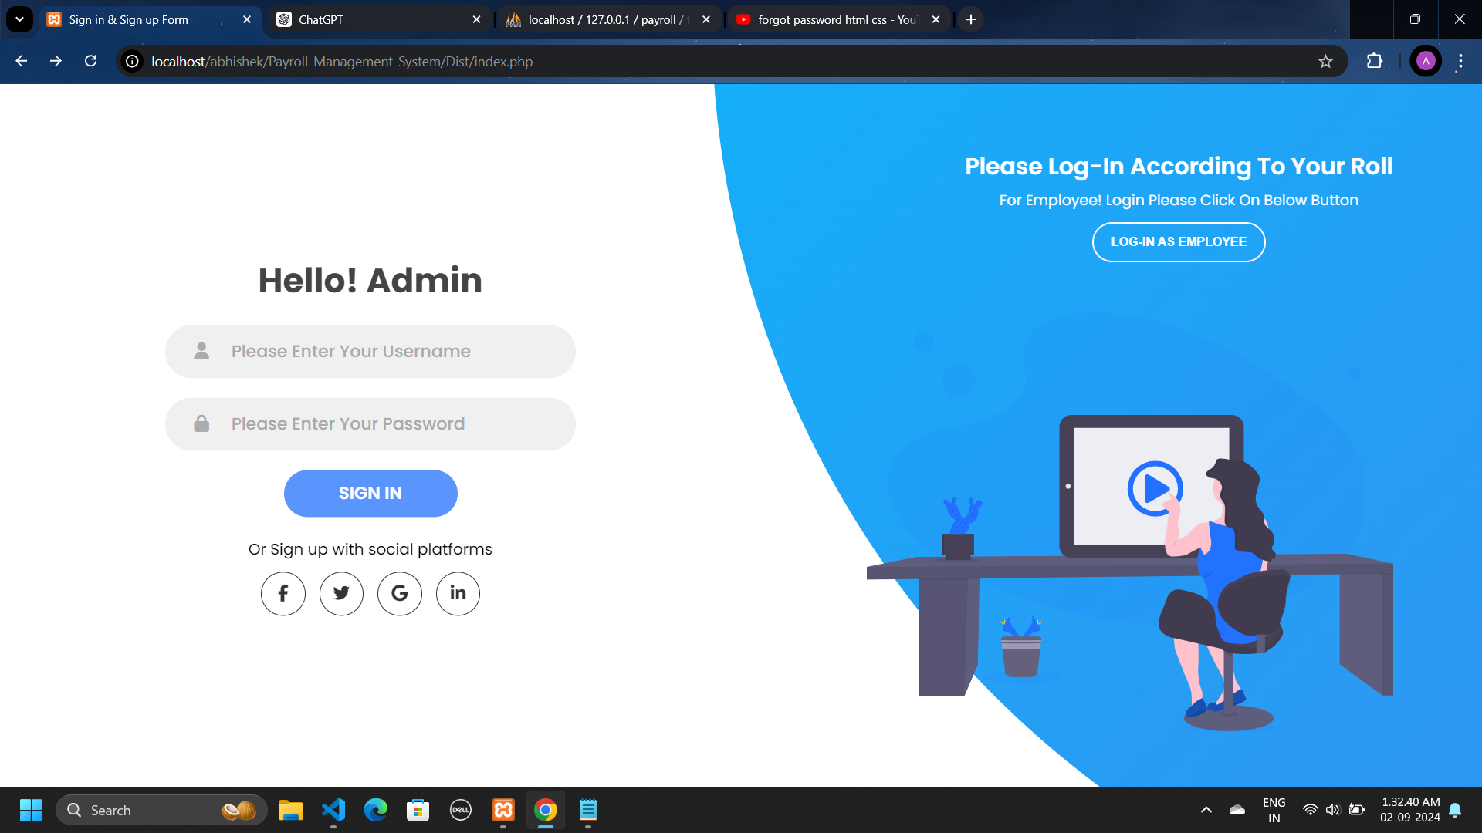
Payroll Management System
System Desing
Input Design
Login Page

Slide 24
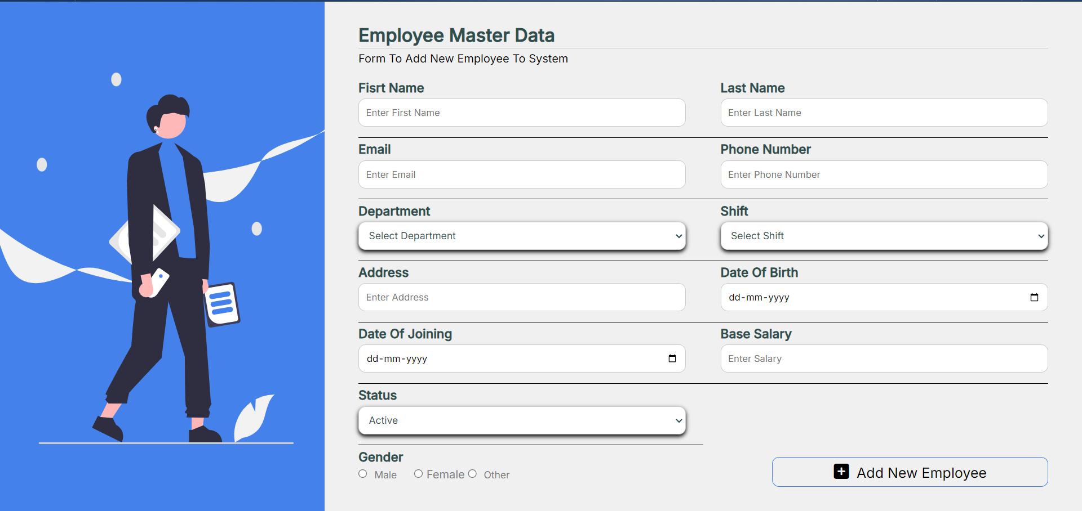
Payroll Management System
System Desing
Input Design
Employee Registration Form

Slide 25
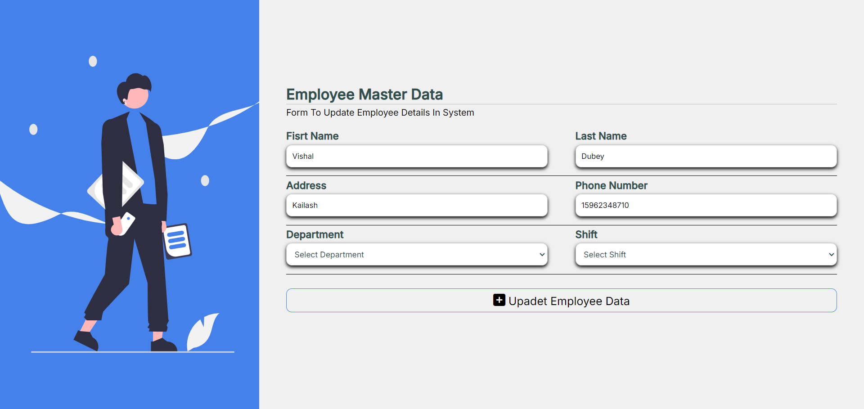
Payroll Management System
System Desing
Input Design
Employee Information Change Form (Admin Side)

Slide 26
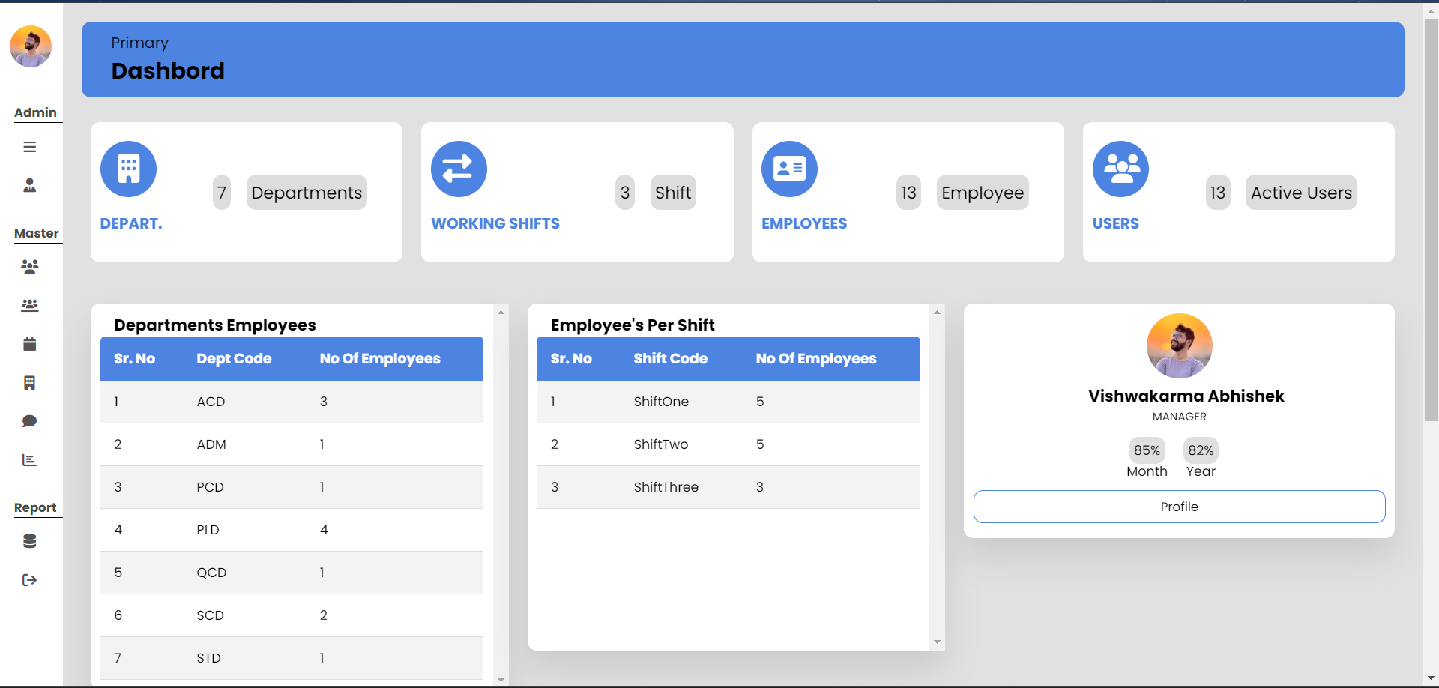
Payroll Management System
System Desing
Output Design
Admin Dashboard

Slide 27
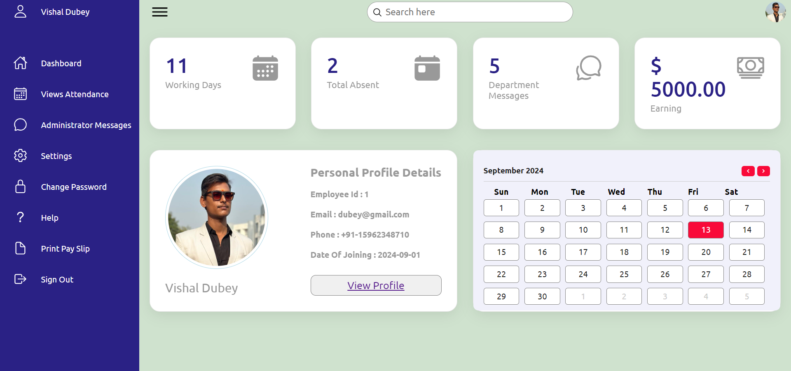
Payroll Management System
System Desing
Output Design
Employee Dashboard

Slide 28
Payroll Management System
Software Testing
Data entry: Test the data entry fields to make sure they are properly formatted and validated. For example, the phone no field should only accept numeric values and 10-digit number and hire date field should only accept date values.
Calculation: Test the payroll calculations to make sure they are accurate. For example, the system should correctly calculate all employee salary accurately.
Security: Test the security of the payroll system to make sure it is protected form unauthorized access. For example, the system should require users to authenticate themselves before they can access sensitive data.
Reports: Test the payroll reports to make sure they are accurate and easy to read. For example, the system should generate a report that list all employees and their pay stubs for a given period.

Slide 29
Payroll Management System
Limitation and Future Scope of Enhancements
Limitation:
Internet is required
Proper data is required
Future scope of Enhancements:
Make the system more user-friendly.
Use AI and Machine Learning.
Automate more tasks.
Make the system more secure.
Make the mobile app for system.

Slide 30
Payroll Management System
Thank You !

